Slide 1
Module 10: Monitoring Models
Notes:
Continuous monitoring is a key element of machine learning operationalization.

Slide 2


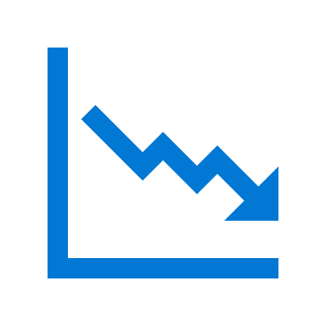
Agenda
Monitoring Models with Application Insights
Monitoring Data Drift
Notes:
In this module, you'll explore two kinds of monitoring:
- Monitoring deployed model activity using Azure Application Insights
- Monitoring data drift

Slide 3
Monitoring Models with Application Insights
Notes:
After a machine learning model has been deployed into production, it's important to understand how it is being used by capturing and viewing telemetry.

Slide 4

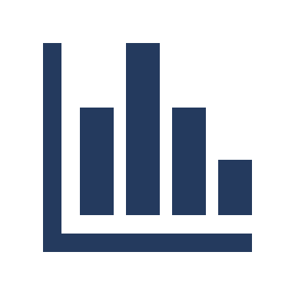


What is Application Insights?
An Application Performance Management service in Azure
Enables capture, storage, and analysis of telemetry data
Notes:
Application Insights is an application performance management service in Microsoft Azure that enables the capture, storage, and analysis of telemetry data from applications.
You can use Application Insights to monitor telemetry from many kinds of application, including applications that are not running in Azure. All that's required is a low-overhead instrumentation package to capture and send the telemetry data to Application Insights. The necessary package is already included in Azure Machine Learning Web services, so you can use it to capture and review telemetry from models published with Azure Machine Learning.
To log telemetry in application insights from an Azure machine learning service, you must have an Application Insights resource associated with your Azure Machine Learning workspace, and you must configure your service to use it for telemetry logging.
When you create an Azure Machine Learning workspace, you can select an Azure Application Insights resource to associate with it. If you do not select an existing Application Insights resource, a new one is created in the same resource group as your workspace.

Slide 5
Enabling Application Insights
Determine the Application Insights resource for your workspace
Enable in a new service deployment configuration using the SDK:
Enable for existing deployed services:
Configure AKS deployment in Azure Machine Learning studio
Update deployed service using the SDK
ws.get_details()['applicationInsights']
deploy_config = Webservice.deploy_configuration(enable_app_insights=True)
service.update(enable_app_insights=True)
Notes:
You can determine the Application Insights resource associated with your workspace by viewing the Overview page of the workspace blade in the Azure portal, or by using the get_details() method of a Workspace object as shown on the slide.
When deploying a new real-time service, you can enable Application Insights in the deployment configuration for the service, as shown on the slide.
If you want to enable Application Insights for a service that is already deployed, you can modify the deployment configuration for Azure Kubernetes Service (AKS) based services in the Azure portal. Alternatively, you can update any web service by using the Azure Machine Learning SDK, as shown on the slide.

Slide 6
Capturing and Viewing Application Insights Data
Print log data in the scoring script
Query Logs in Application Insights
def init():
model = joblib.load(Model.get_model_path('my_model'))
def run(raw_data):
data = json.loads(raw_data)['data']
predictions = model.predict(data)
log_txt = 'Data:' + str(data) + ' - Predictions:' + str(predictions)
print(log_txt)
traces
|where message == "STDOUT" and customDimensions.["Service Name"] = "my-svc"
| project timestamp, customDimensions.Content
timestamp | customDimensions_Content
01/02/2020, 9:11:57.846 PM | Data:[[1, 2, 2.5, 3.1], [0, 1, 1,7, 2.1]] - Predictions:[0 1]
Notes:
Application Insights automatically captures any information written to the standard output and error logs, and provides a query capability to view data in these logs.
To capture telemetry data for Application insights, you can write any values to the standard output log in the scoring script for your service by using a `print` statement.
Azure Machine Learning creates a *custom dimension* in the Application Insights data model for the output you write. To analyze captured log data, you can use the Log Analytics query interface for Application Insights in the Azure portal. This interface supports a SQL-like query syntax that you can use to extract fields from logged data, including custom dimensions created by your Azure Machine Learning service.
The query on the slide returns the timestamp and customDimensions.Content fields from log traces that have a message field value of STDOUT (indicating the data is in the standard output log) and a customDimensions.["Service Name"] field value of my-svc.

Slide 7
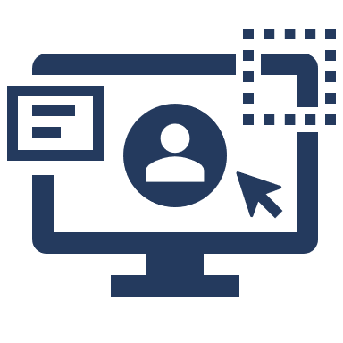
Lab: Monitor a Model
View the lab instructions at https://aka.ms/mslearn-dp100
Complete the Monitor a model exercise
Notes:
Students can complete the lab using only a browser and the Azure subscription they created previously. The lab instructions are at the address on the slide.
Alternatively, if students are using a hosted environment to complete the lab, get them to start it and find ther appropriate exercise instructions..

Slide 8
Monitoring Data Drift
Notes:
Changing trends in data over time can reduce the accuracy of the predictions made by a model. Monitoring for this data drift is an important way to ensure your model continues to predict accurately.

Slide 9
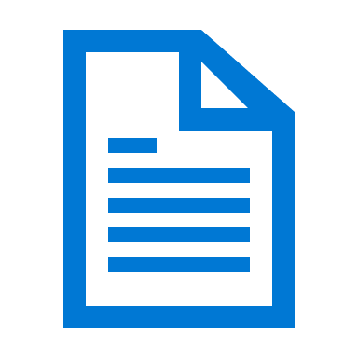


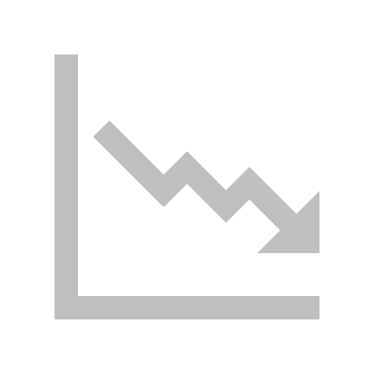
What is Data Drift?
Changing data trends that can affect the accuracy of trained models
Jan
y
Feb
y✗
Notes:
You typically train a machine learning model using a historical dataset that is representative of the new data that your model will receive for inferencing. However, over time there may be trends that change the profile of the data, making your model less accurate.
For example, suppose a model is trained to predict the expected gas mileage of an automobile based on the number of cylinders, engine size, weight, and other features. Over time, as car manufacturing and engine technologies advance, the typical fuel-efficiency of vehicles might improve dramatically; making the predictions made by the model trained on older data less accurate.
This change in data profiles between training and inferencing is known as data drift, and it can be a significant issue for predictive models used in production. It is therefore important to be able to monitor data drift over time, and retrain models as required to maintain predictive accuracy.

Slide 10
Creating a Data Drift Monitor
Monitor by Comparing Datasets
Baseline dataset (original training data)
Target dataset for comparison over time (requires timestamp column)
Backfill to populate a data drift profile from target dataset
monitor = DataDriftDetector.create_from_datasets(ws, 'dataset-drift-detector',
baseline_data_set, target_data_set, ...)
backfill = monitor.backfill(dt.datetime.now() - dt.timedelta(days=30), dt.datetime.now())
Notes:
Azure Machine Learning supports data drift monitoring through the use of *datasets*. You can compare two registered datasets to detect data drift, or you can capture new feature data submitted to a deployed model service and compare it to the dataset with which the model was trained.
## Monitor data drift by comparing datasets
It's common for organizations to continue to collect new data after a model has been trained. For example, a health clinic might use diagnostic measurements from previous patients to train a model that predicts diabetes likelihood, but continue to collect the same diagnostic measurements from all new patients. The clinic's data scientists could then periodically compare the growing collection of new data to the original training data, and identify any changing data trends that might affect model accuracy.
To monitor data drift using registered datasets, you need to register two datasets: - A baseline dataset - usually the original training data.
- A target dataset that will be compared to the baseline based on time intervals. This dataset requires a column for each feature you want to compare, and a timestamp column so the rate of data drift can be measured.
After creating these datasets, you can define a dataset monitor to detect data drift and trigger alerts if the rate of drift exceeds a specified threshold. You can create dataset monitors using the visual interface in Azure Machine Learning studio, or by using the DataDriftDetector class in the Azure Machine Learning SDK as shown on the slide.
After creating the dataset monitor, you can backfill to immediately compare the baseline dataset to existing data in the target dataset, as shown in the example on the slide, which backfills the monitor based on changes in data for the previous 30 days:

Slide 11
Data Drift Schedules and Alerts
On creation, specify:
Frequency
Drift threshold for alerting
Alert configuration
Schedule start (for model data drift monitors)
Data latency (for dataset data drift monitors)
alert_email AlertConfiguration('data_scientists@contoso.com')
monitor = DataDriftDetector.create_from_datasets(ws, 'dataset-drift-detector',
baseline_data_set, target_data_set,
compute_target=cpu_cluster,
frequency='Week', latency=2,
drift_threshold=.3,
alert_configuration=alert_email)
Notes:
When you define a data monitor, you specify a schedule on which it should run. Additionally, you can specify a threshold for the rate of data drift and an operator email address for notifications if this threshold is exceeded.
Data drift monitoring works by running a comparison at scheduled frequency, and calculating data drift metrics for the features in the dataset that you want to monitor. You can define a schedule to run every Day, Week, or Month.
For dataset monitors, you can specify a latency, indicating the number of hours to allow for new data to be collected and added to the target dataset. For deployed model data drift monitors, you can specify a schedule_start time value to indicate when the data drift run should start (if omitted, the run will start at the current time).
Data drift is measured using a calculated magnitude of change in the statistical distribution of feature values over time. You can expect some natural random variation between the baseline and target datasets, but you should monitor for large changes that might indicate significant data drift.
You can define a threshold for data drift magnitude above which you want to be notified, and configure alert notifications by email. The code on the slide shows an example of scheduling a data drift monitor to run every week, and send an alert if the drift magnitude is greater than 0.3:

Slide 12
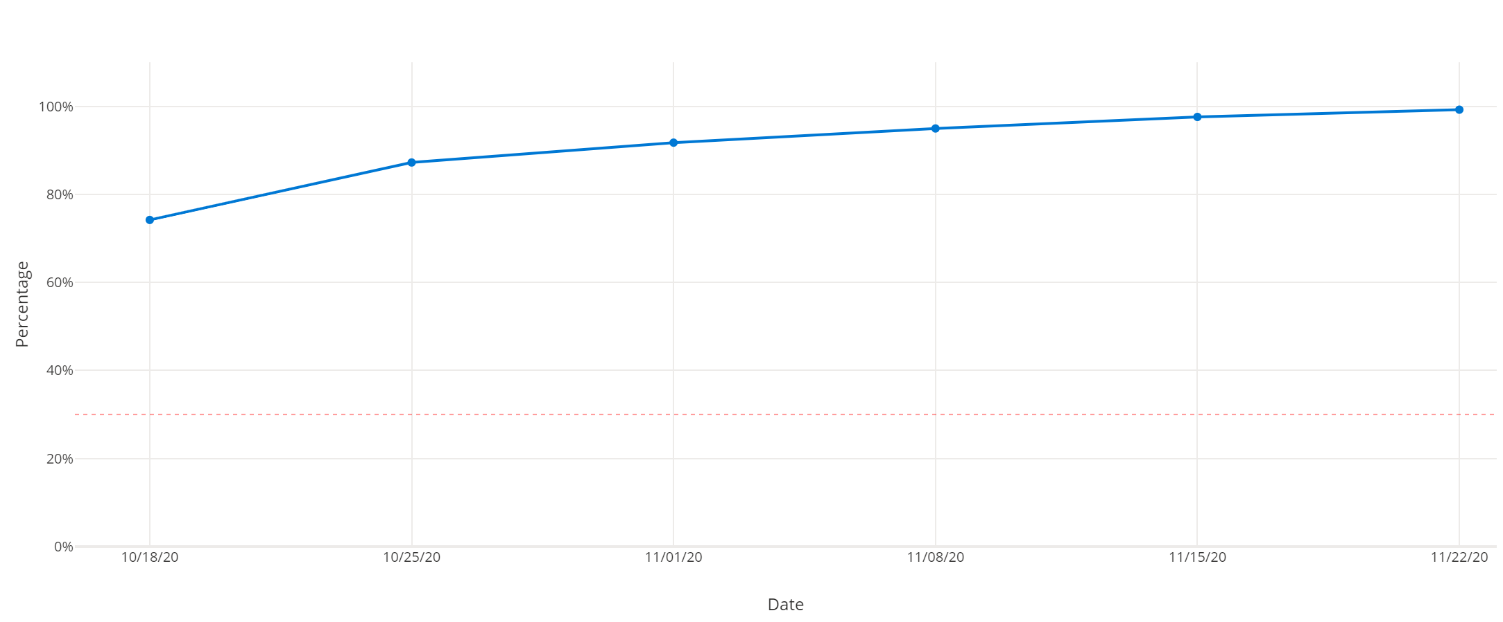
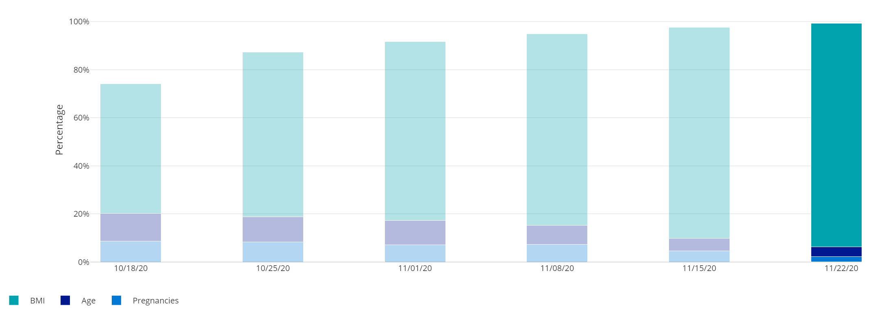
Reviewing Data Drift
Drift Magnitude Trend
Drift Magnitude by Features
Notes:
You can view the data drift metrics your monitor has collected in Azure Machine Learning studio.
To see data drift for datasets, view the Dataset monitors tab of the Datasets page.
Data drift visualizations for datasets and models include the overall data drift magnitude, and a measure of contribution to data drift for each feature. You can also see details of data drift for individual features.

Slide 13
Lab: Monitor Data Drift
View the lab instructions at https://aka.ms/mslearn-dp100
Complete the Monitor data drift exercise
Notes:
Students can complete the lab using only a browser and the Azure subscription they created previously. The lab instructions are at the address on the slide.
Alternatively, if students are using a hosted environment to complete the lab, get them to start it and find ther appropriate exercise instructions..

Slide 14

Knowledge check
You want to capture metrics from a real-time inference service and analyze them using Application Insights. What must you do in the scoring script for the service?
Use the Run.log method to log the metrics.
Save the metrics in the ./outputs folder.
Use a print statement to write the metrics in the STDOUT log.
You previously trained a model using a training dataset. You want to detect any data drift in the new data collected since the model was trained. What should you do?
Create a new version of the dataset using only the new data; and retrain the model.
Add the new data to the existing dataset and enable Application Insights for the service where the model is deployed.
Create a new dataset using the new data and a timestamp column; and create a data drift monitor that uses the training dataset as a baseline and the new dataset as a target.
Notes:
Use the slide animations to reveal the correct answers.

Slide 15
References
Microsoft Learn: Monitor models with Azure Machine Learning
https://docs.microsoft.com/learn/modules/monitor-models-with-azure-machine-learning
Microsoft Learn: Monitor data drift with Azure Machine Learning
https://docs.microsoft.com/learn/modules/monitor-data-drift-with-azure-machine-learning
Azure Machine Learning monitoring with Application Insights documentation
https://docs.microsoft.com/azure/machine-learning/how-to-enable-app-insights
Azure Machine Learning data drift documentation
https://docs.microsoft.com/azure/machine-learning/how-to-monitor-datasets
Notes:
Use the references on the slide to learn more. In particular, note the online learning modules on Microsoft Learn that are related to the material covered in this module.

Slide 16
Closing slide

